Slide 1
English-Speaking Union Branch Town Hall
January 16, 2024

Slide 2
AGENDA
Greetings and Welcome Dr. E Quinn Peeper Karen Karpowich
Program Updates Maryellen Liotta Alice Uhl Rona Weitz
Shakespeare
TLab
EiA Across America
Membership Renewal Anthony DiFilippo Kathy Morrisett
Patron Tour - Veneto Karen Karpowich
Web Grace Darling
Finance Anthony DiFilippo Karen Karpowich
New Initiatives Karen Karpowich

Slide 3
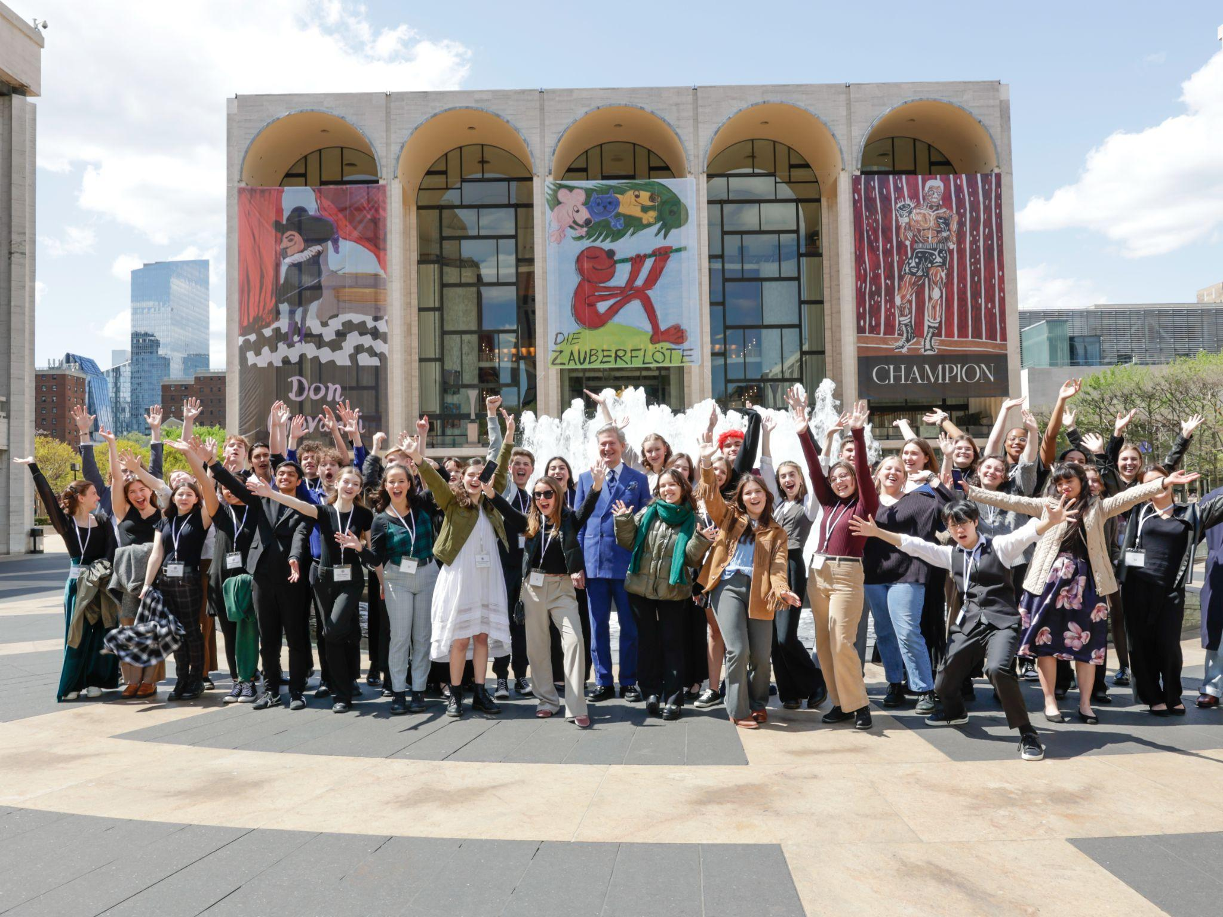
ESU National Shakespeare Competition
2024 Prizes:
1st Place - British American Drama Academy Mid-Summer at Oxford
2nd Place - American Shakespeare Theatre Camp in Staunton, VA
3rd Place - $1000
NSC Finals will be held at the
Mitzi Newhouse Theater at Lincoln Center
on Monday, April 15, 2024
44 branch winners, teachers & families will enjoy a fun-filled weekend in NYC!
The ESU will once again offer the popular “family package” at the introductory 2023 rate

Slide 4
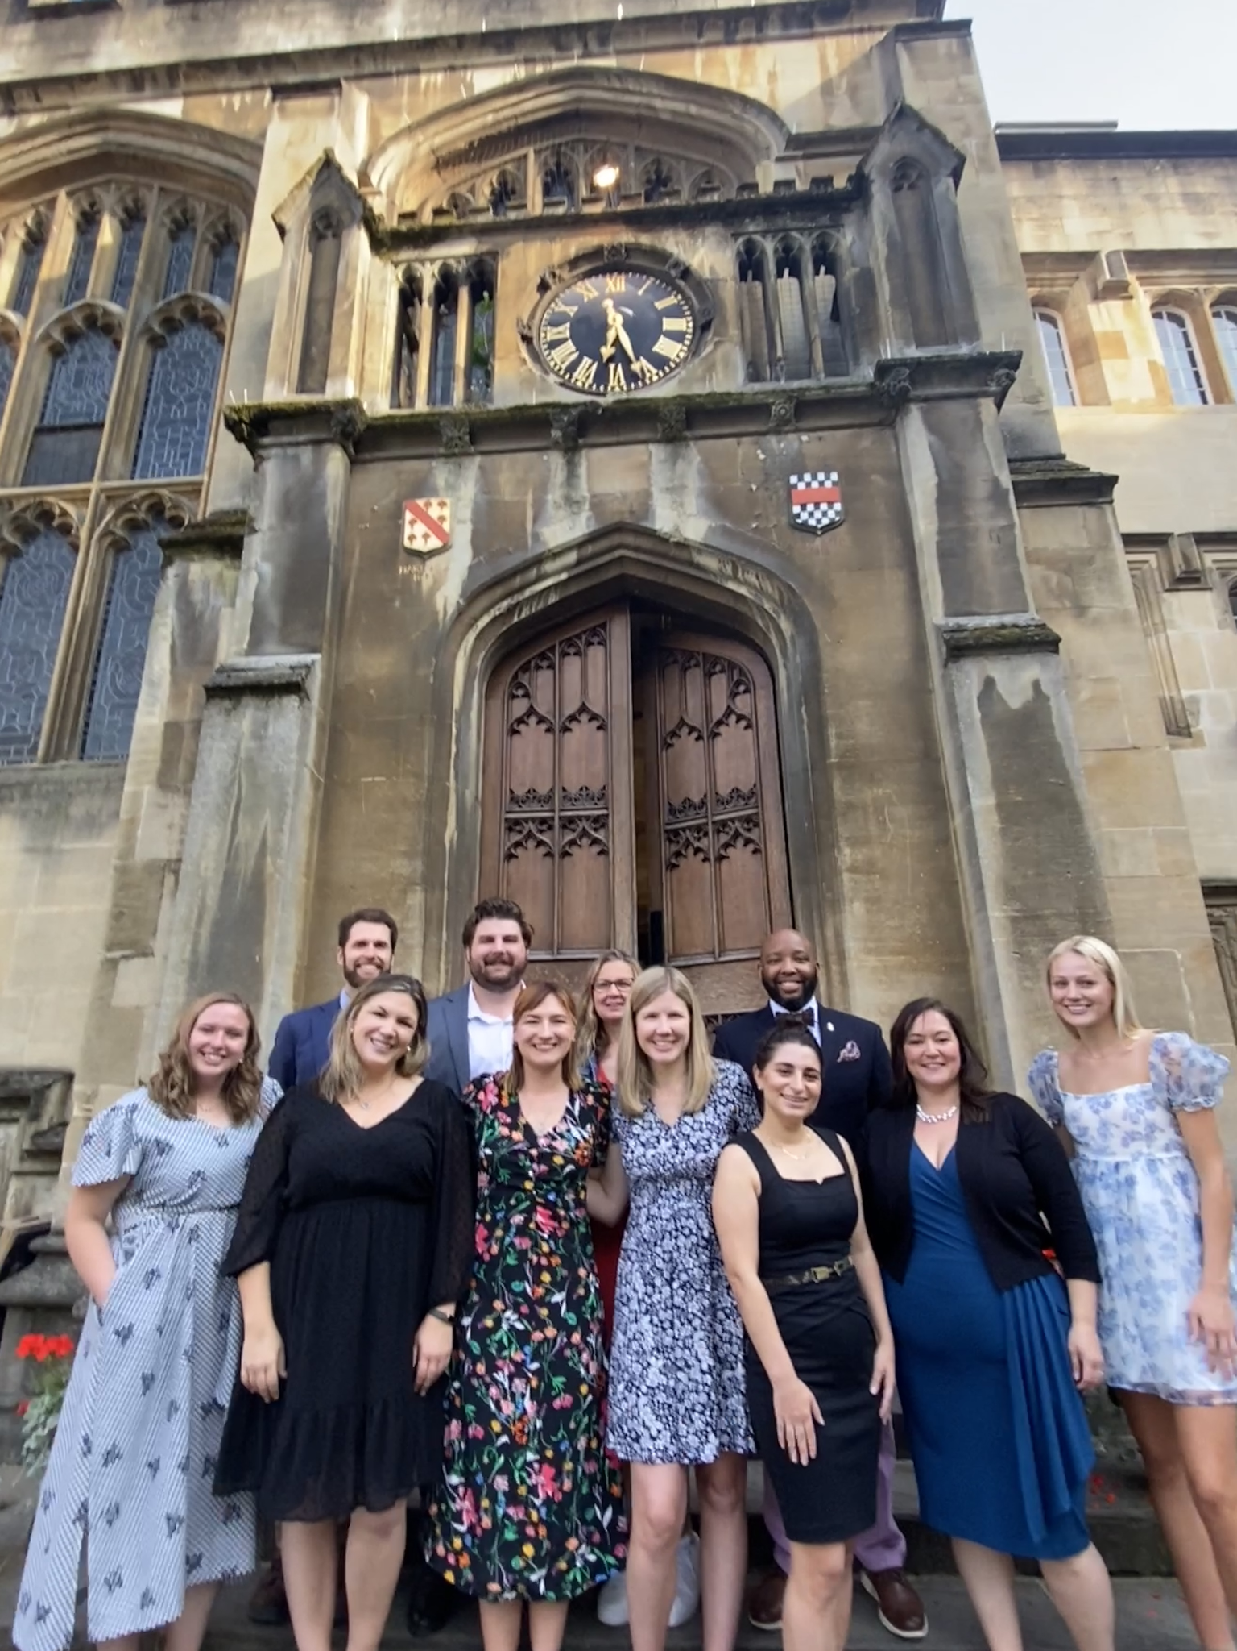
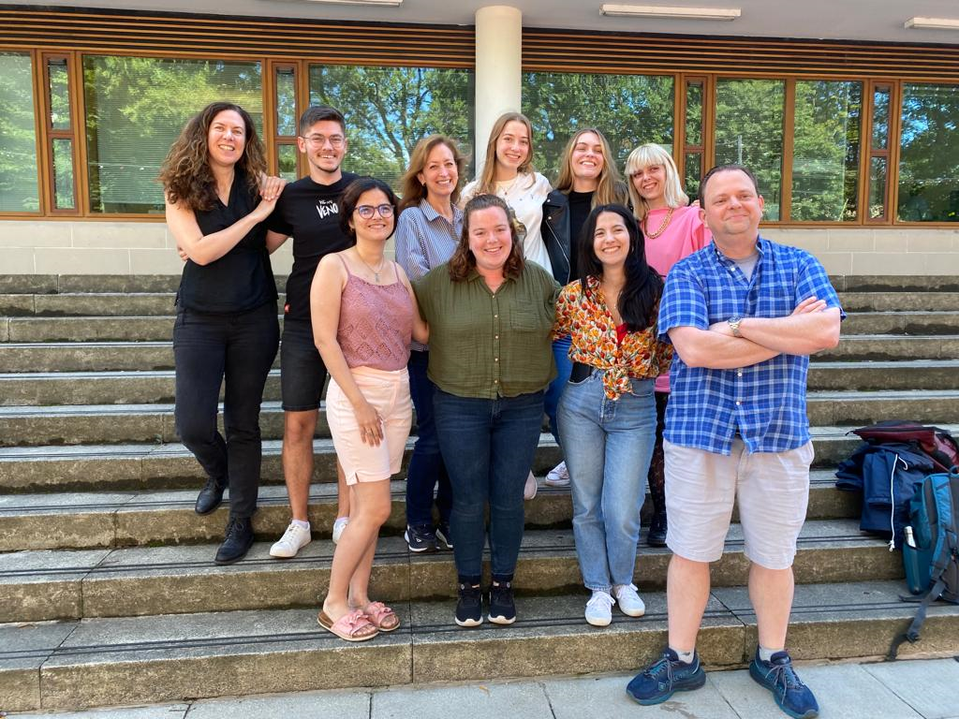
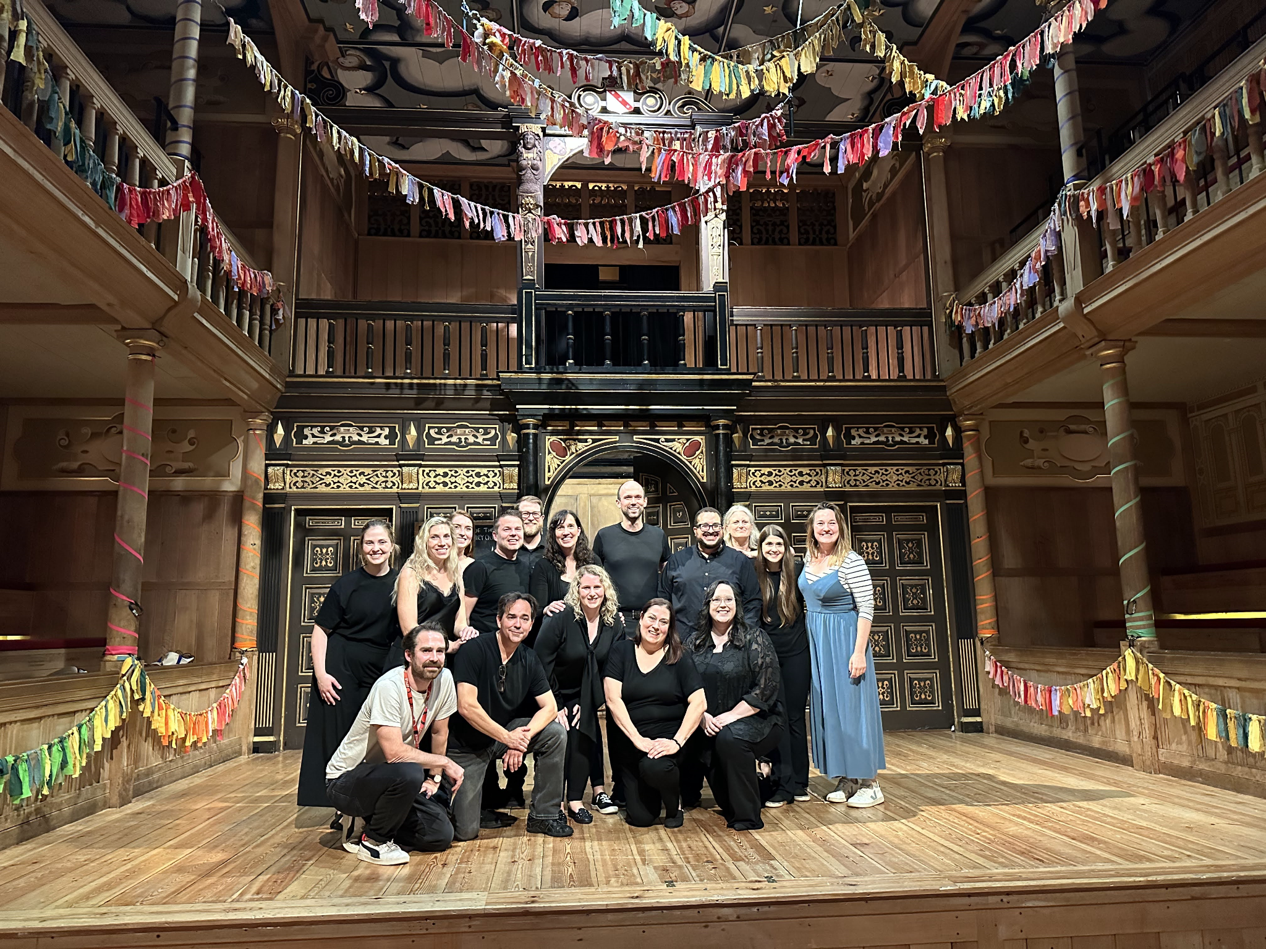
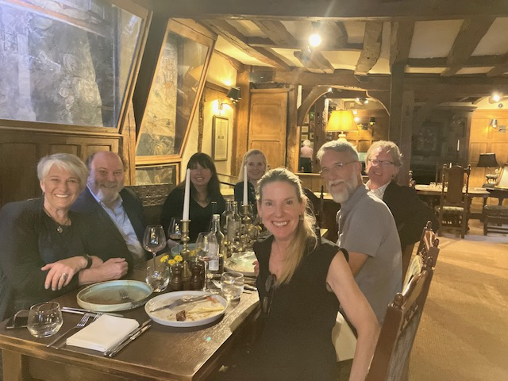
ESU INTERNATIONAL EDUCATION PROGRAMS
TRAVEL AND LEARN ABROAD (TLAB)
Each summer ESU Branches provide TLab Scholarships for teachers to study for 3-weeks at Oxford, Edinburgh and Shakespeare’s Globe in London.
ESU Lifelong Learners’ 1-week summer programs are also available in Oxford at Christ Church & Page to Stage in Stratford-upon-Avon.
“I forged true friendships with incredible teachers from across the country & returned with so much wisdom imparted by Globe educators. I’m so excited to use the TSTP activities in my classroom! – S. Medved, NYC Branch TLab Scholar
“We enjoyed The Oxford Experience so much, we want to go again next summer! – G . Peterson, NC Branch

Slide 5
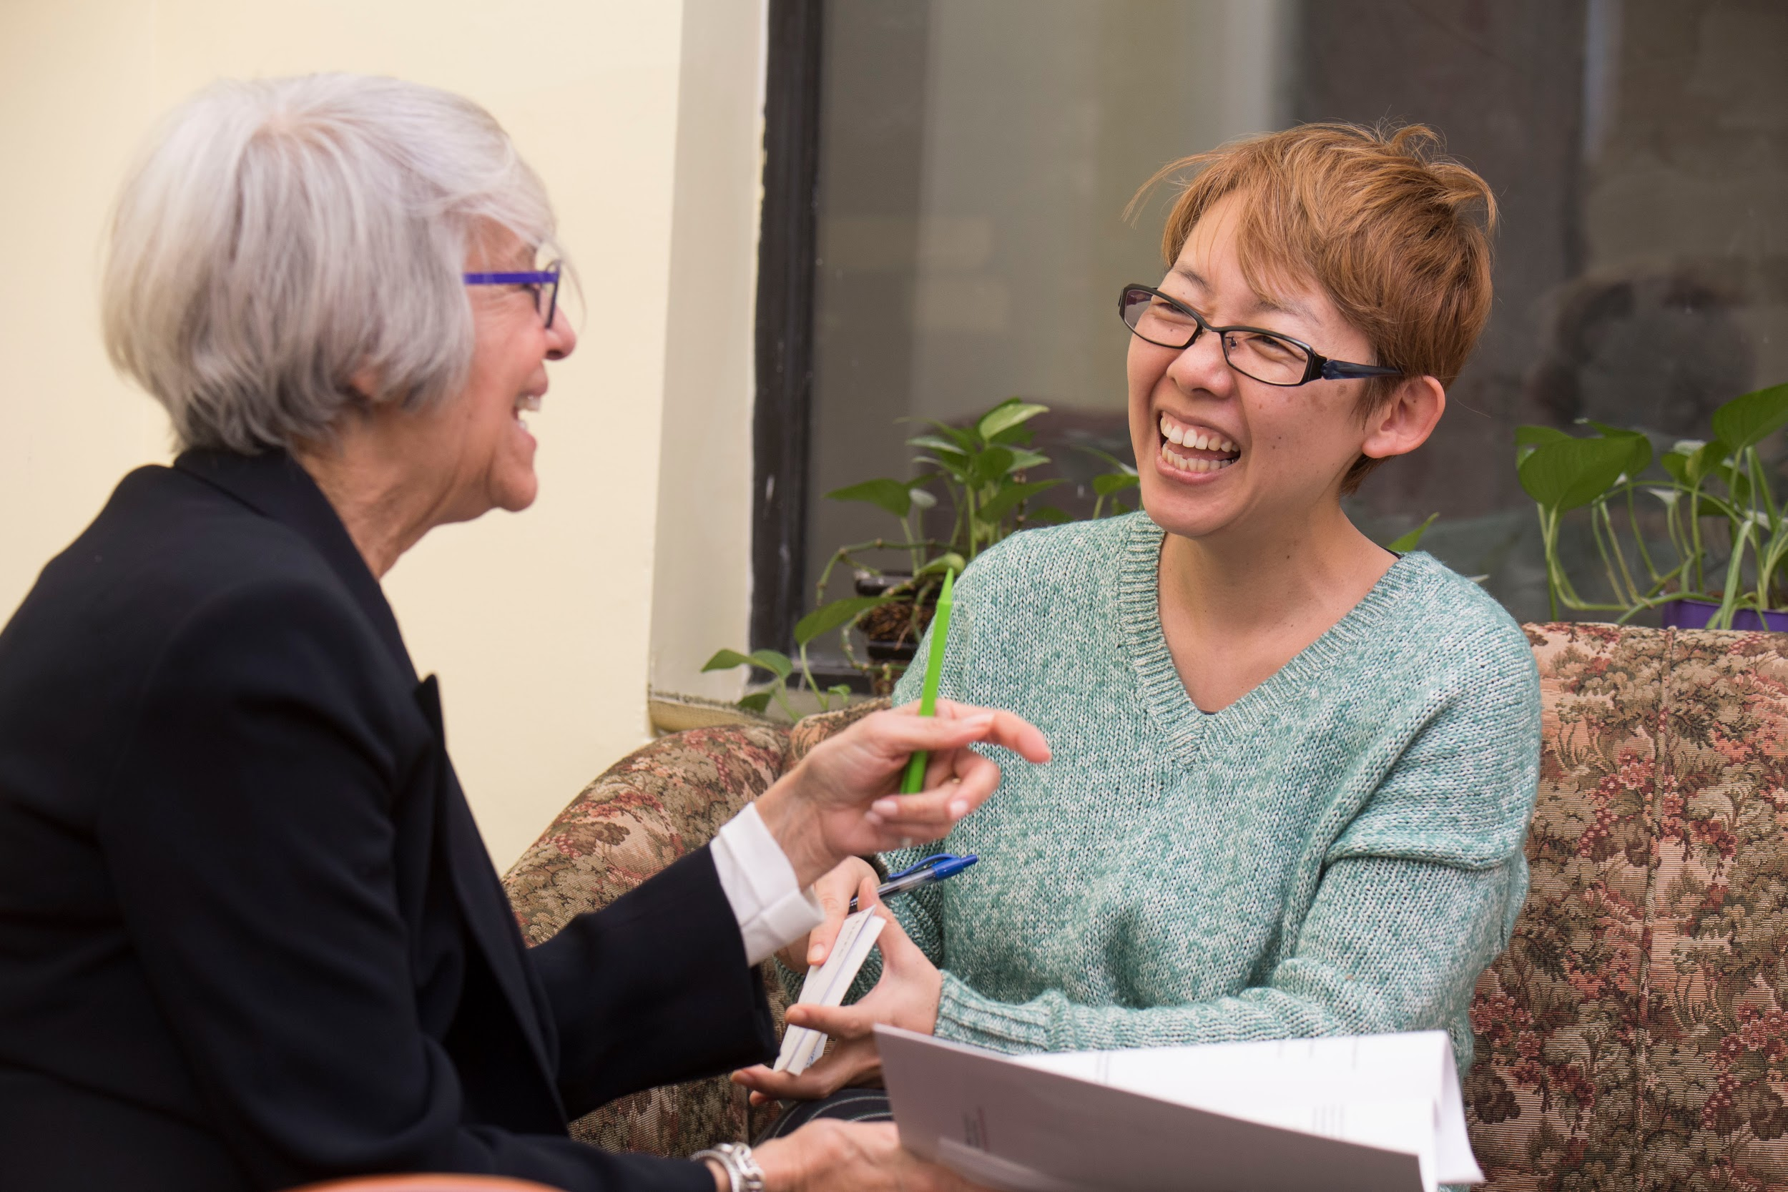
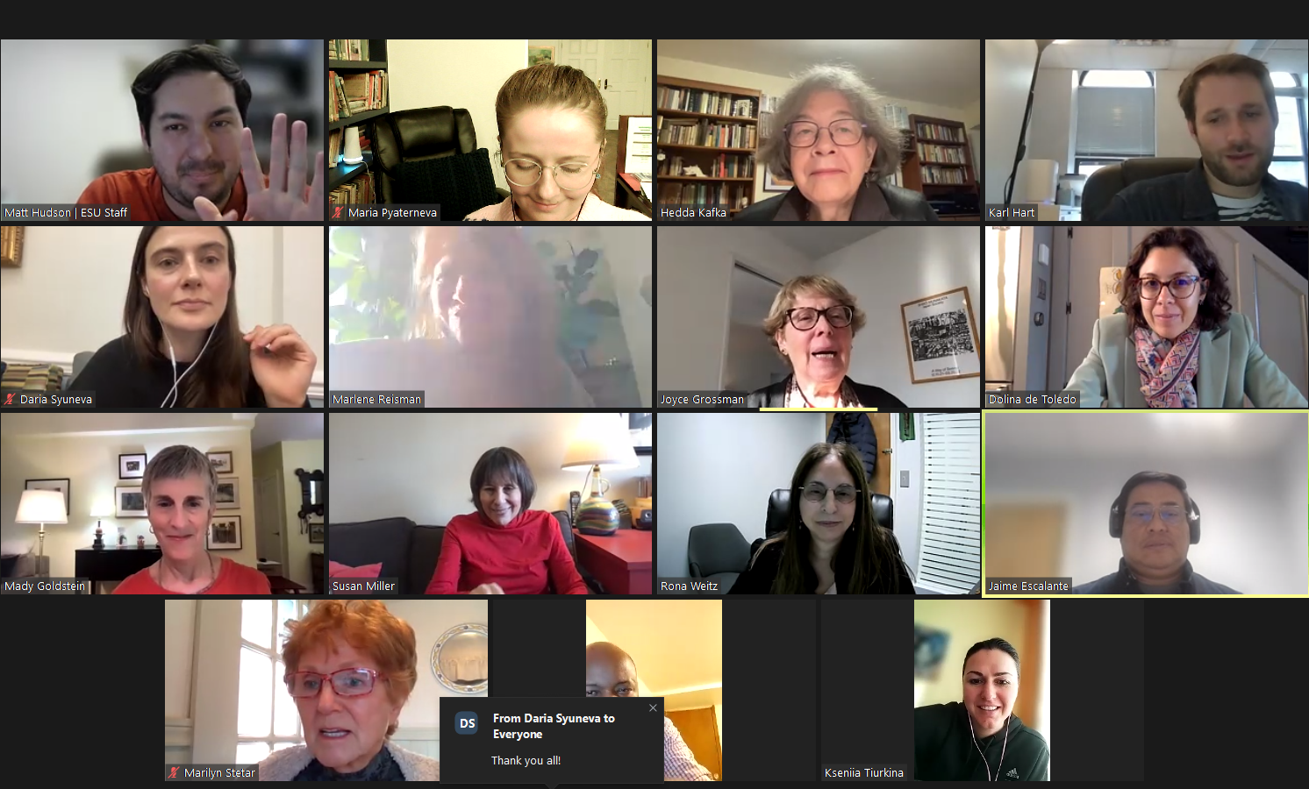
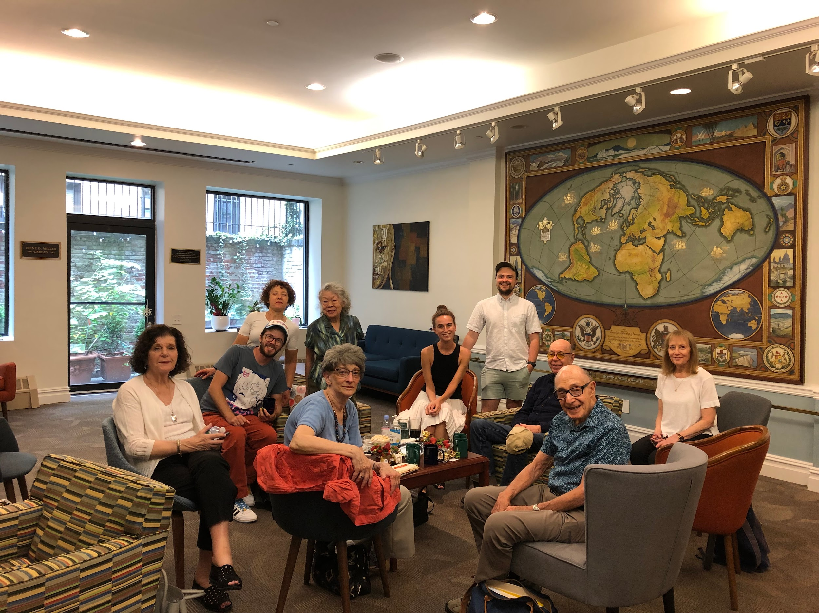
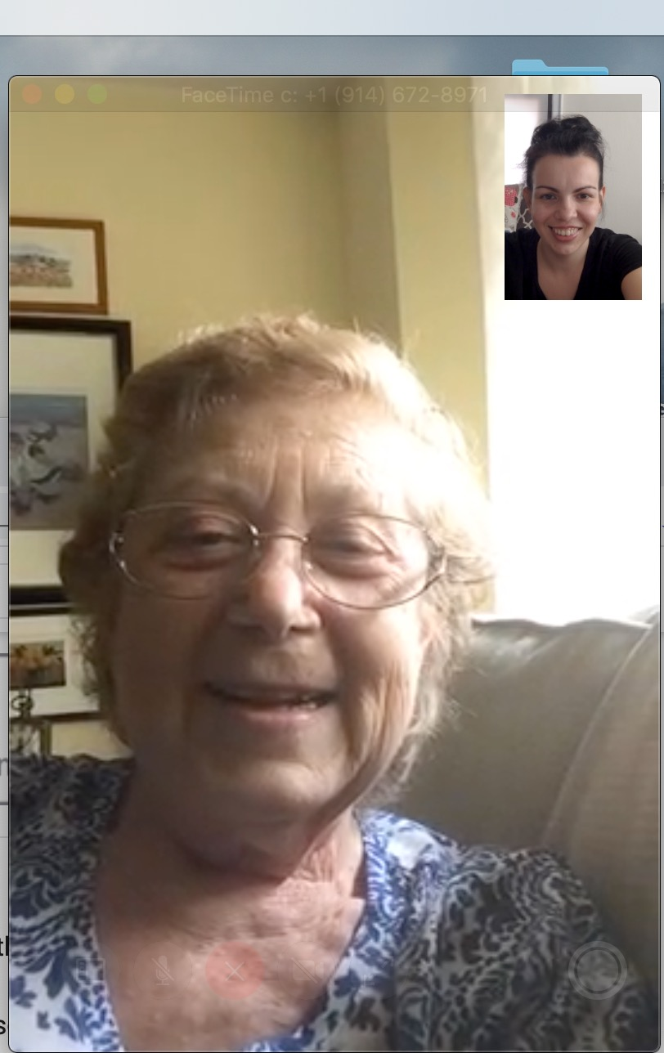
ENGLISH IN ACTION ACROSS AMERICA
An opportunity for ESU branch members to help new immigrants improve their English language skills.
Volunteer in this weekly online tutoring program.
Help new immigrants gain the tools they need to build successful lives here in the United States.
Make a difference in the life of a new immigrant!
“My tutor has been more than a conversation partner, she is a mentor, an inspiration and a friend.”
Student in EiA
Provide a window into U.S. life
Grow and diversify your branch membership
Build up a student’s confidence

Slide 6
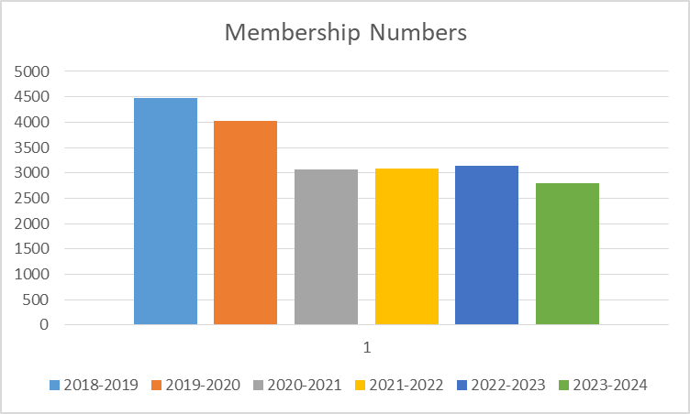
MEMBERSHIP RENEWALS
Memberships July 1, 2023 through January 10, 2024 Regular Couple 660 Regular Single 1101 Patron Couples 137 Patron Singles 106 Total Members 2801 (Couples Count as 2 Members) Total Memberships 2004

Slide 7
PATRON TOUR Veneto
The ESU National Patron Tours enhance our Patrons’ engagement with the ESU community through bespoke experiences of cultural enrichment, educational exploration, and unforgettable adventures.
A Private View of Italy –
Our Italian Partner and Host
Founded by art historian Count Stefano Aluffi-Pentini in 1996, A Private View of Italy encourages guests to appreciate the life of historic palaces and villas, and allows them to discover the inaccessible treasures that are hidden behind closed doors. Through the centuries the Italian aristocracy has preserved their residences, which were designed by architects such as Raphael, Palladio, and Bernini.
245 Patron Members FY 2022-2023

Slide 8
WEB

Slide 9
FINANCE
We have provided the audit team with all required documentation for ESU National.
There has been a delay in the submission of the Branch consolidated financial statements as we are still awaiting 990 workbooks/data from 2 Branch offices.
Once the Branch consolidation is completed and submitted, auditors will 1) ask Branch offices to complete an electronic bank confirmation; and 2) provide supporting documents on selected transactions.
Bao, our Bookkeeper - Branch Support is no longer with the ESU. Please continue to submit your monthly statements and documentation. Jenny Nguyen will be reviewing and compiling your data. Please email me any other questions you may have.
THANK YOU FOR YOUR CONTINUED SUPPORT

Slide 10
NEW INITIATIVES
Task Force
Purpose:
The Task Force will work to strengthen and grow our mission to ensure the long-term sustainability of the English-Speaking Union of the United States. The group, comprised of ESU stakeholders (members of the National Board, National Staff and Branch Leadership) will evaluate
how issues like declining association membership trends, aging demographics and the pandemic have affected this mission. A key focus will be on supporting the role of members, branches and beneficiaries in this process. The group will always consider our financial challenge of containing costs and securing the resources required to advance our current mission and programs over the next 3-5 years.
Members:
Ellen Alley - President Shreveport Branch
Randy Brannen – President Savannah Branch
Anthony DiFilippo – Controller
Barbara Hughes – Director at Large, Chair of Education Committee
Rossana Ivanova – Development Officer
Kate Nitzken - President Kentucky Branch & T Lab Scholar
Susan Phillips – President Atlanta Branch
Alice Uhl – Director of International Programs, Shakespeare & Debate
Noel Sloan – Treasurer, Chair Audit Committee & SSE Alum
Michelle Seale – Director at Large, Chair of Finance Committee
Bruce Thompson – Director at Large, Luard Alum
Rona Weitz – Director of Immigrant Programs

Slide 11
NEW INITIATIVES (con’t)
Executive Leadership Program via Zoom
Purpose
To advance the role of current ESU Leaders
Support and cultivate new Branch leadership to ensure succession planning
Support Branch with new membership growth
Operational and programmatic support
Wrench Committee Chair - Dr. Julia van der Water
ESU Directory
AGM/ICM 2024 - Cleveland, OH

Slide 12
Q&A
THANK YOU AGAIN

