Slide 1
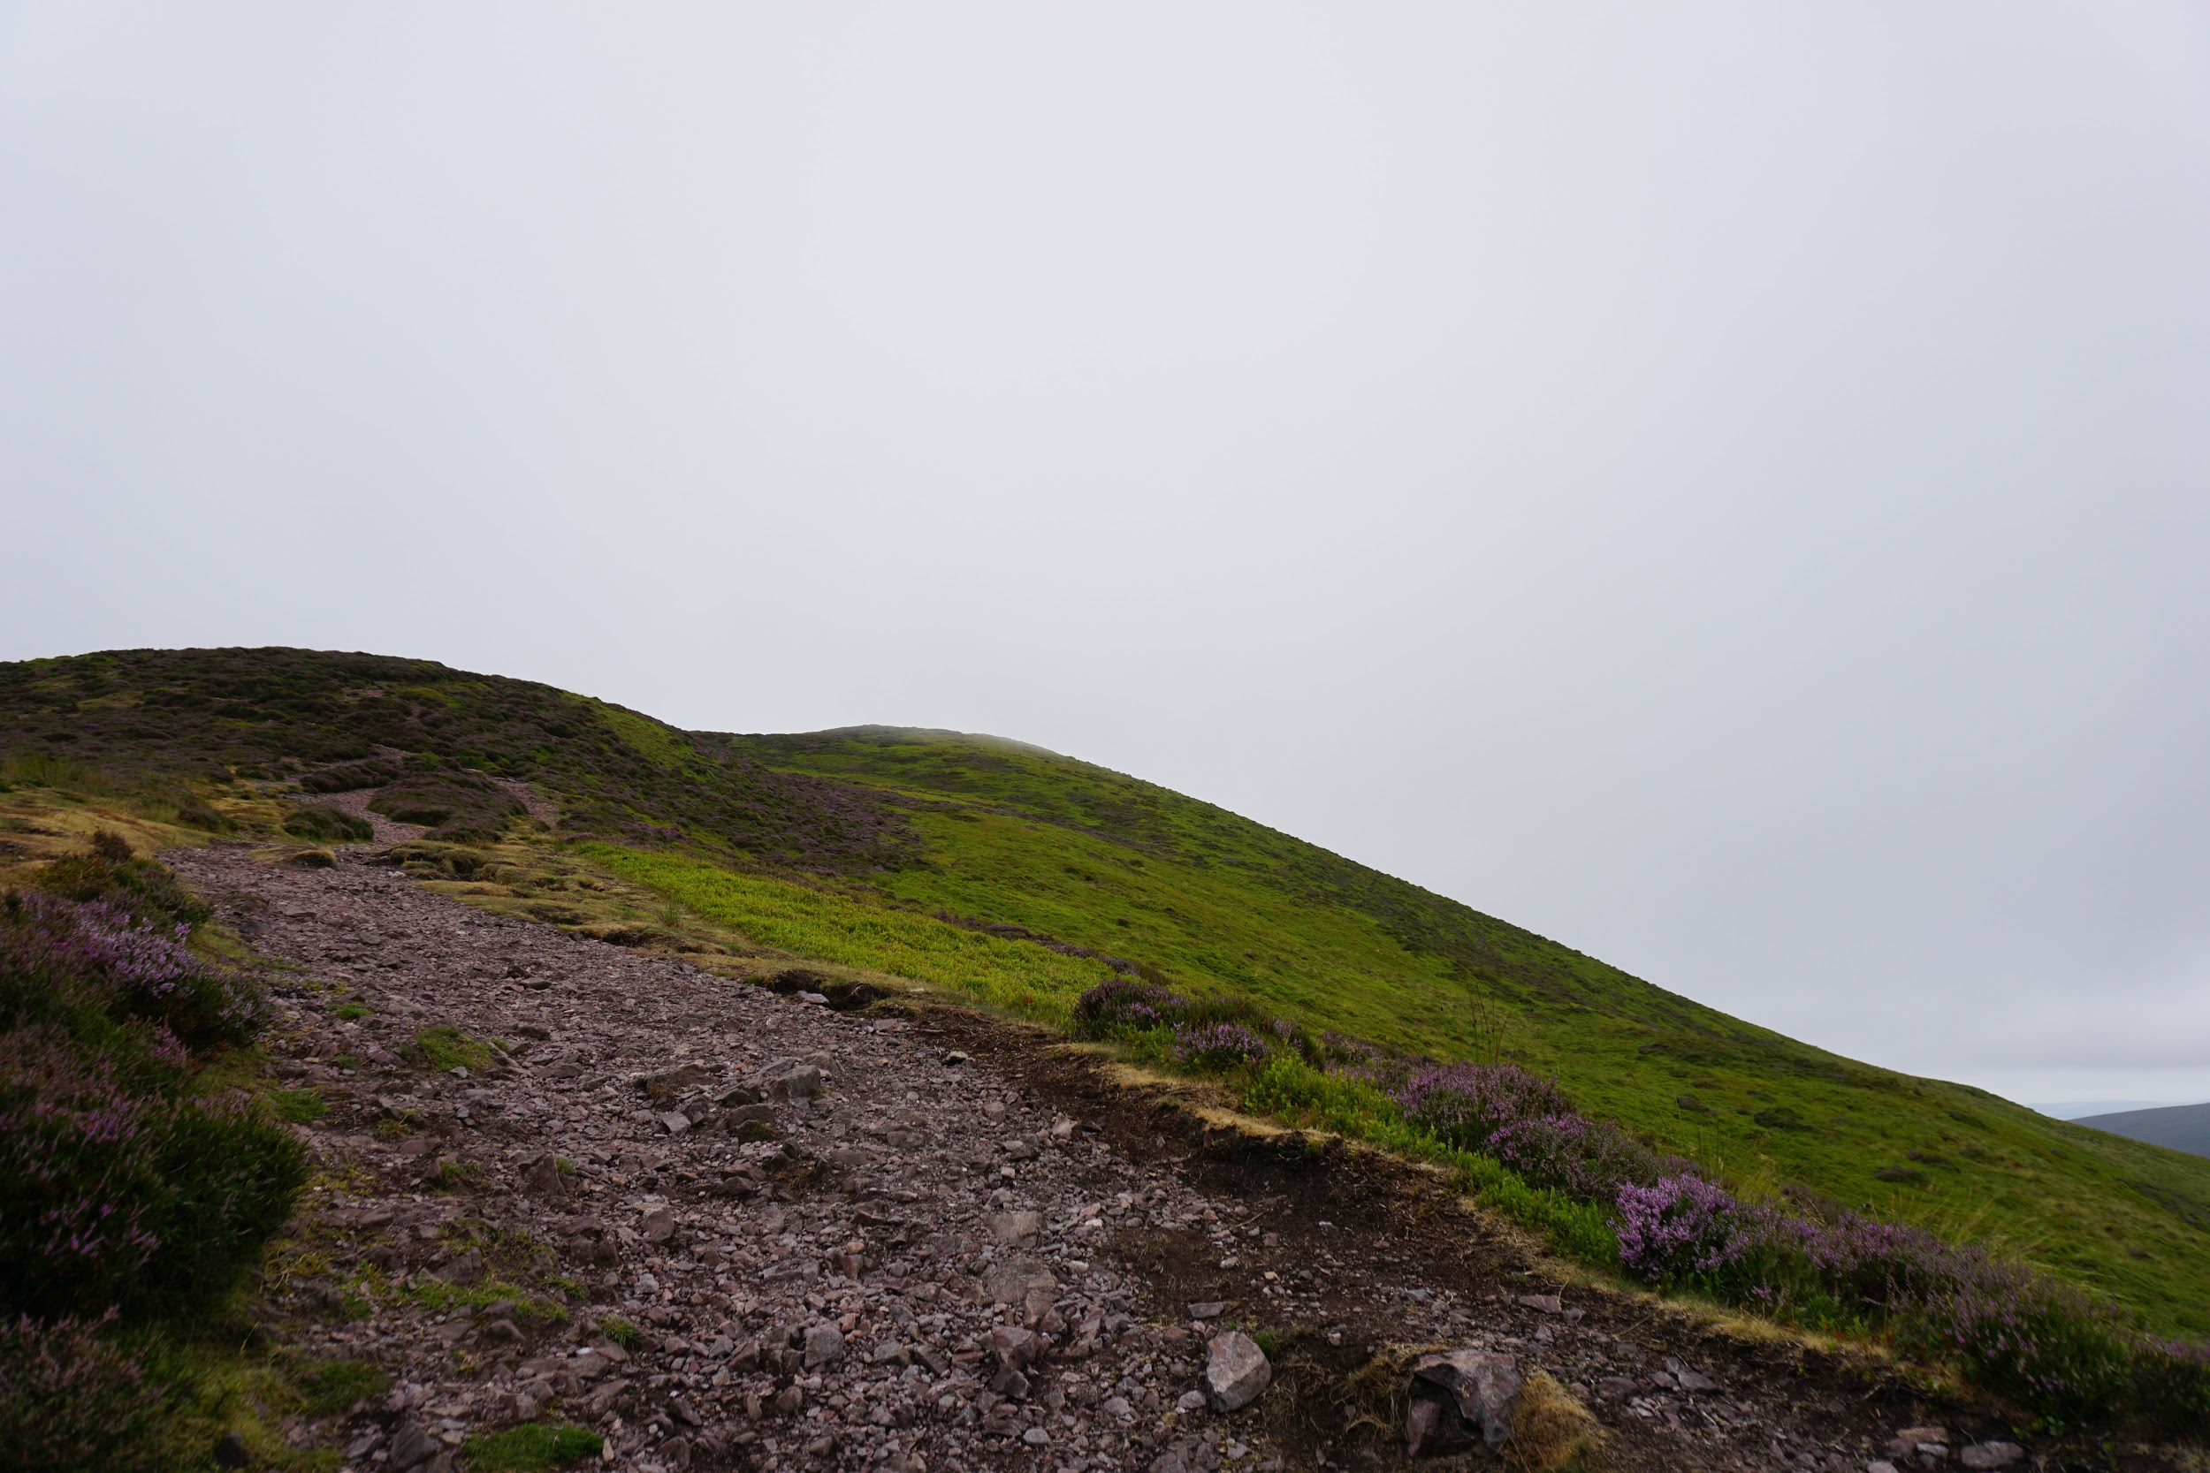
SUISS via ESU’s TLab

Slide 2
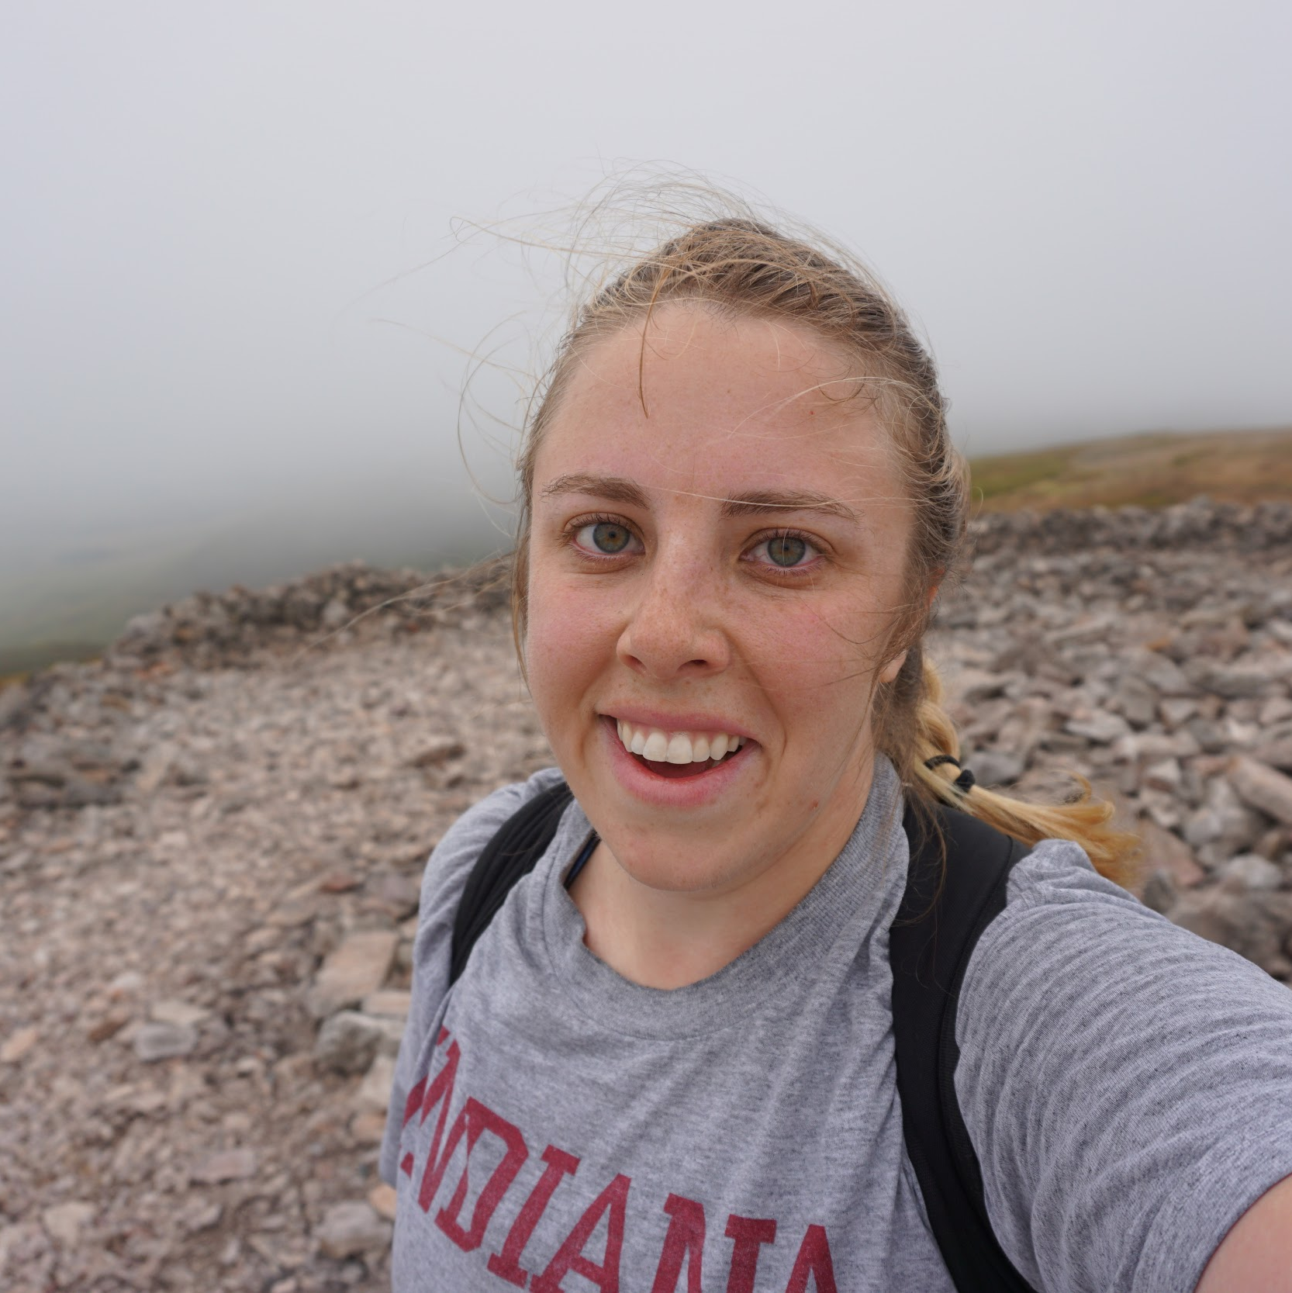
HI! I’M HILARY
Teacher:
Indian Creek High School: AP Literature & Composition, AP Language & Composition, English 9 Honors, & Creative Writing
Teacher of the Year, 2017
Writer:
MFA in screenwriting from Pepperdine University
Young adult literature & comedy screenplays

Slide 3
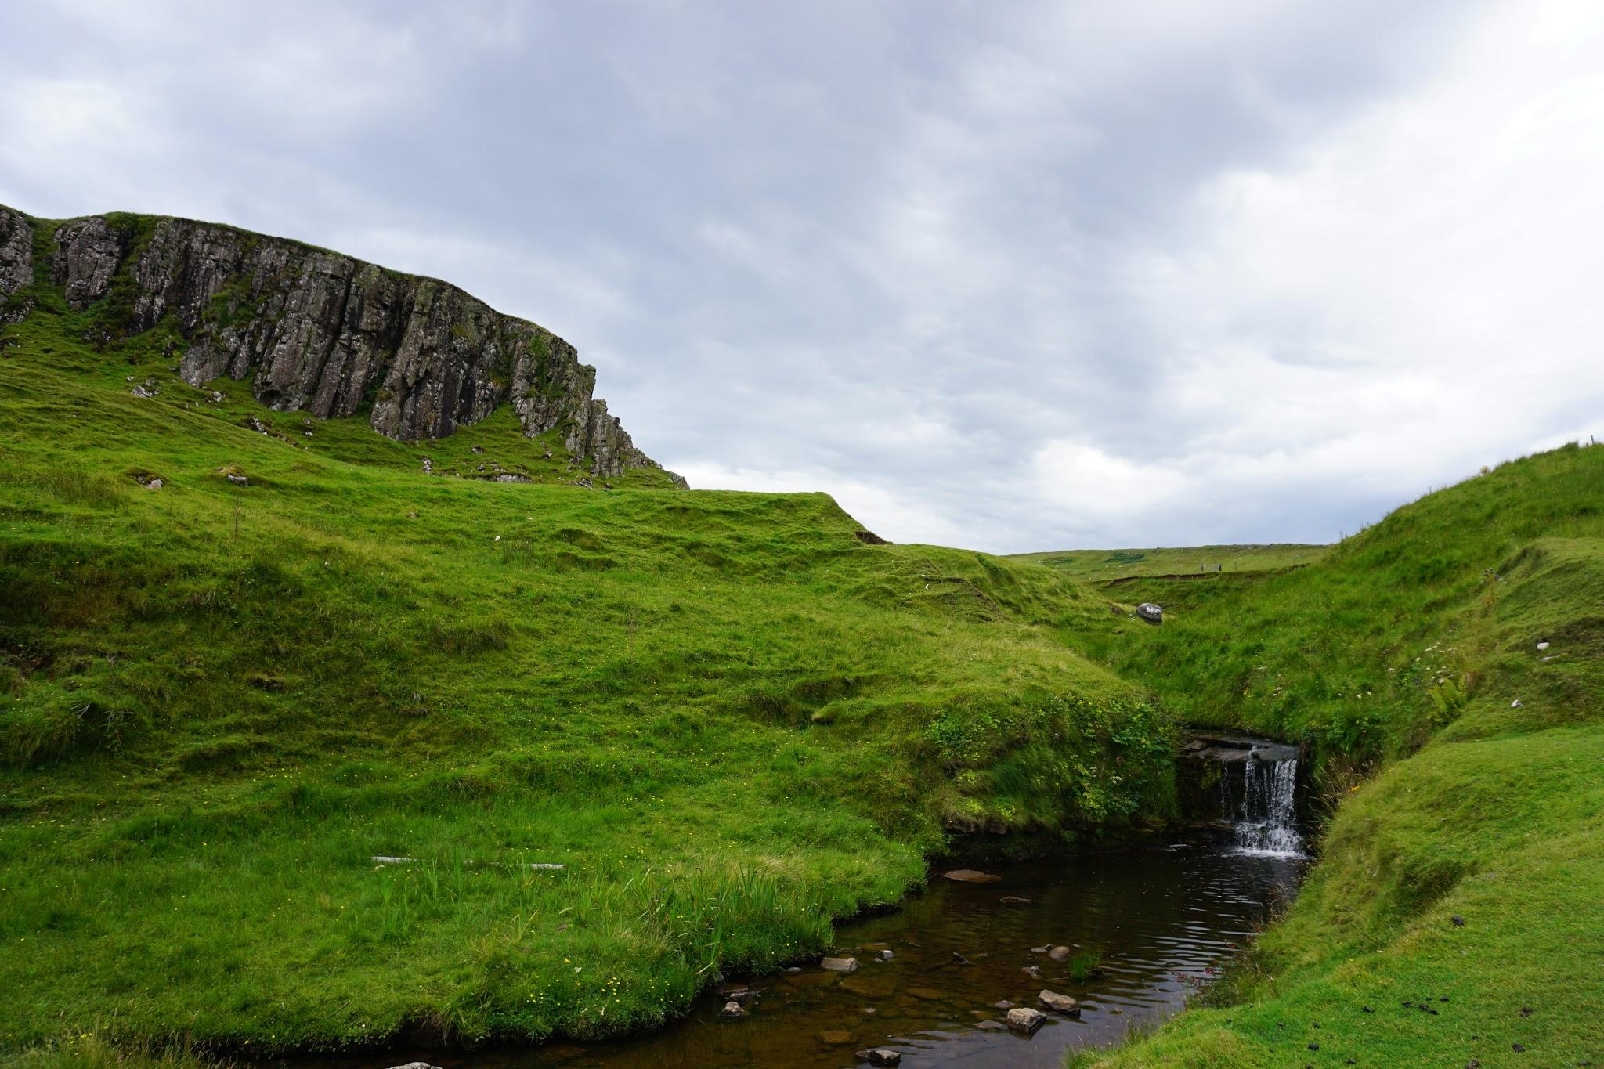
But most importantly,
I had the pleasure of attending SUISS this summer in Edinburgh because of ESUUS Indianapolis!

Slide 4
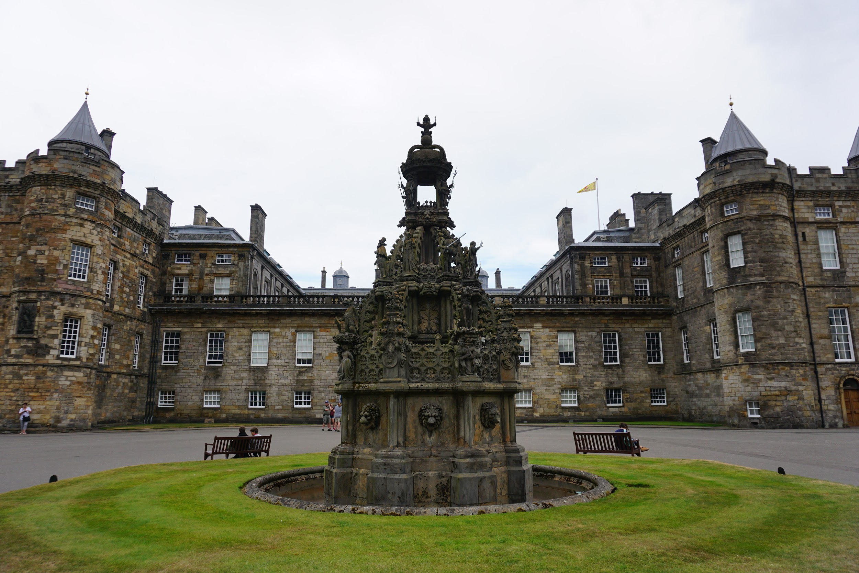

Slide 5
SUISS PROGRAM
Lectures on Modernism and Scottish Literature
Writing Workshops
Writing Masterclasses
Edinburgh Cultural Experiences
Author & Poet Readings

Slide 6
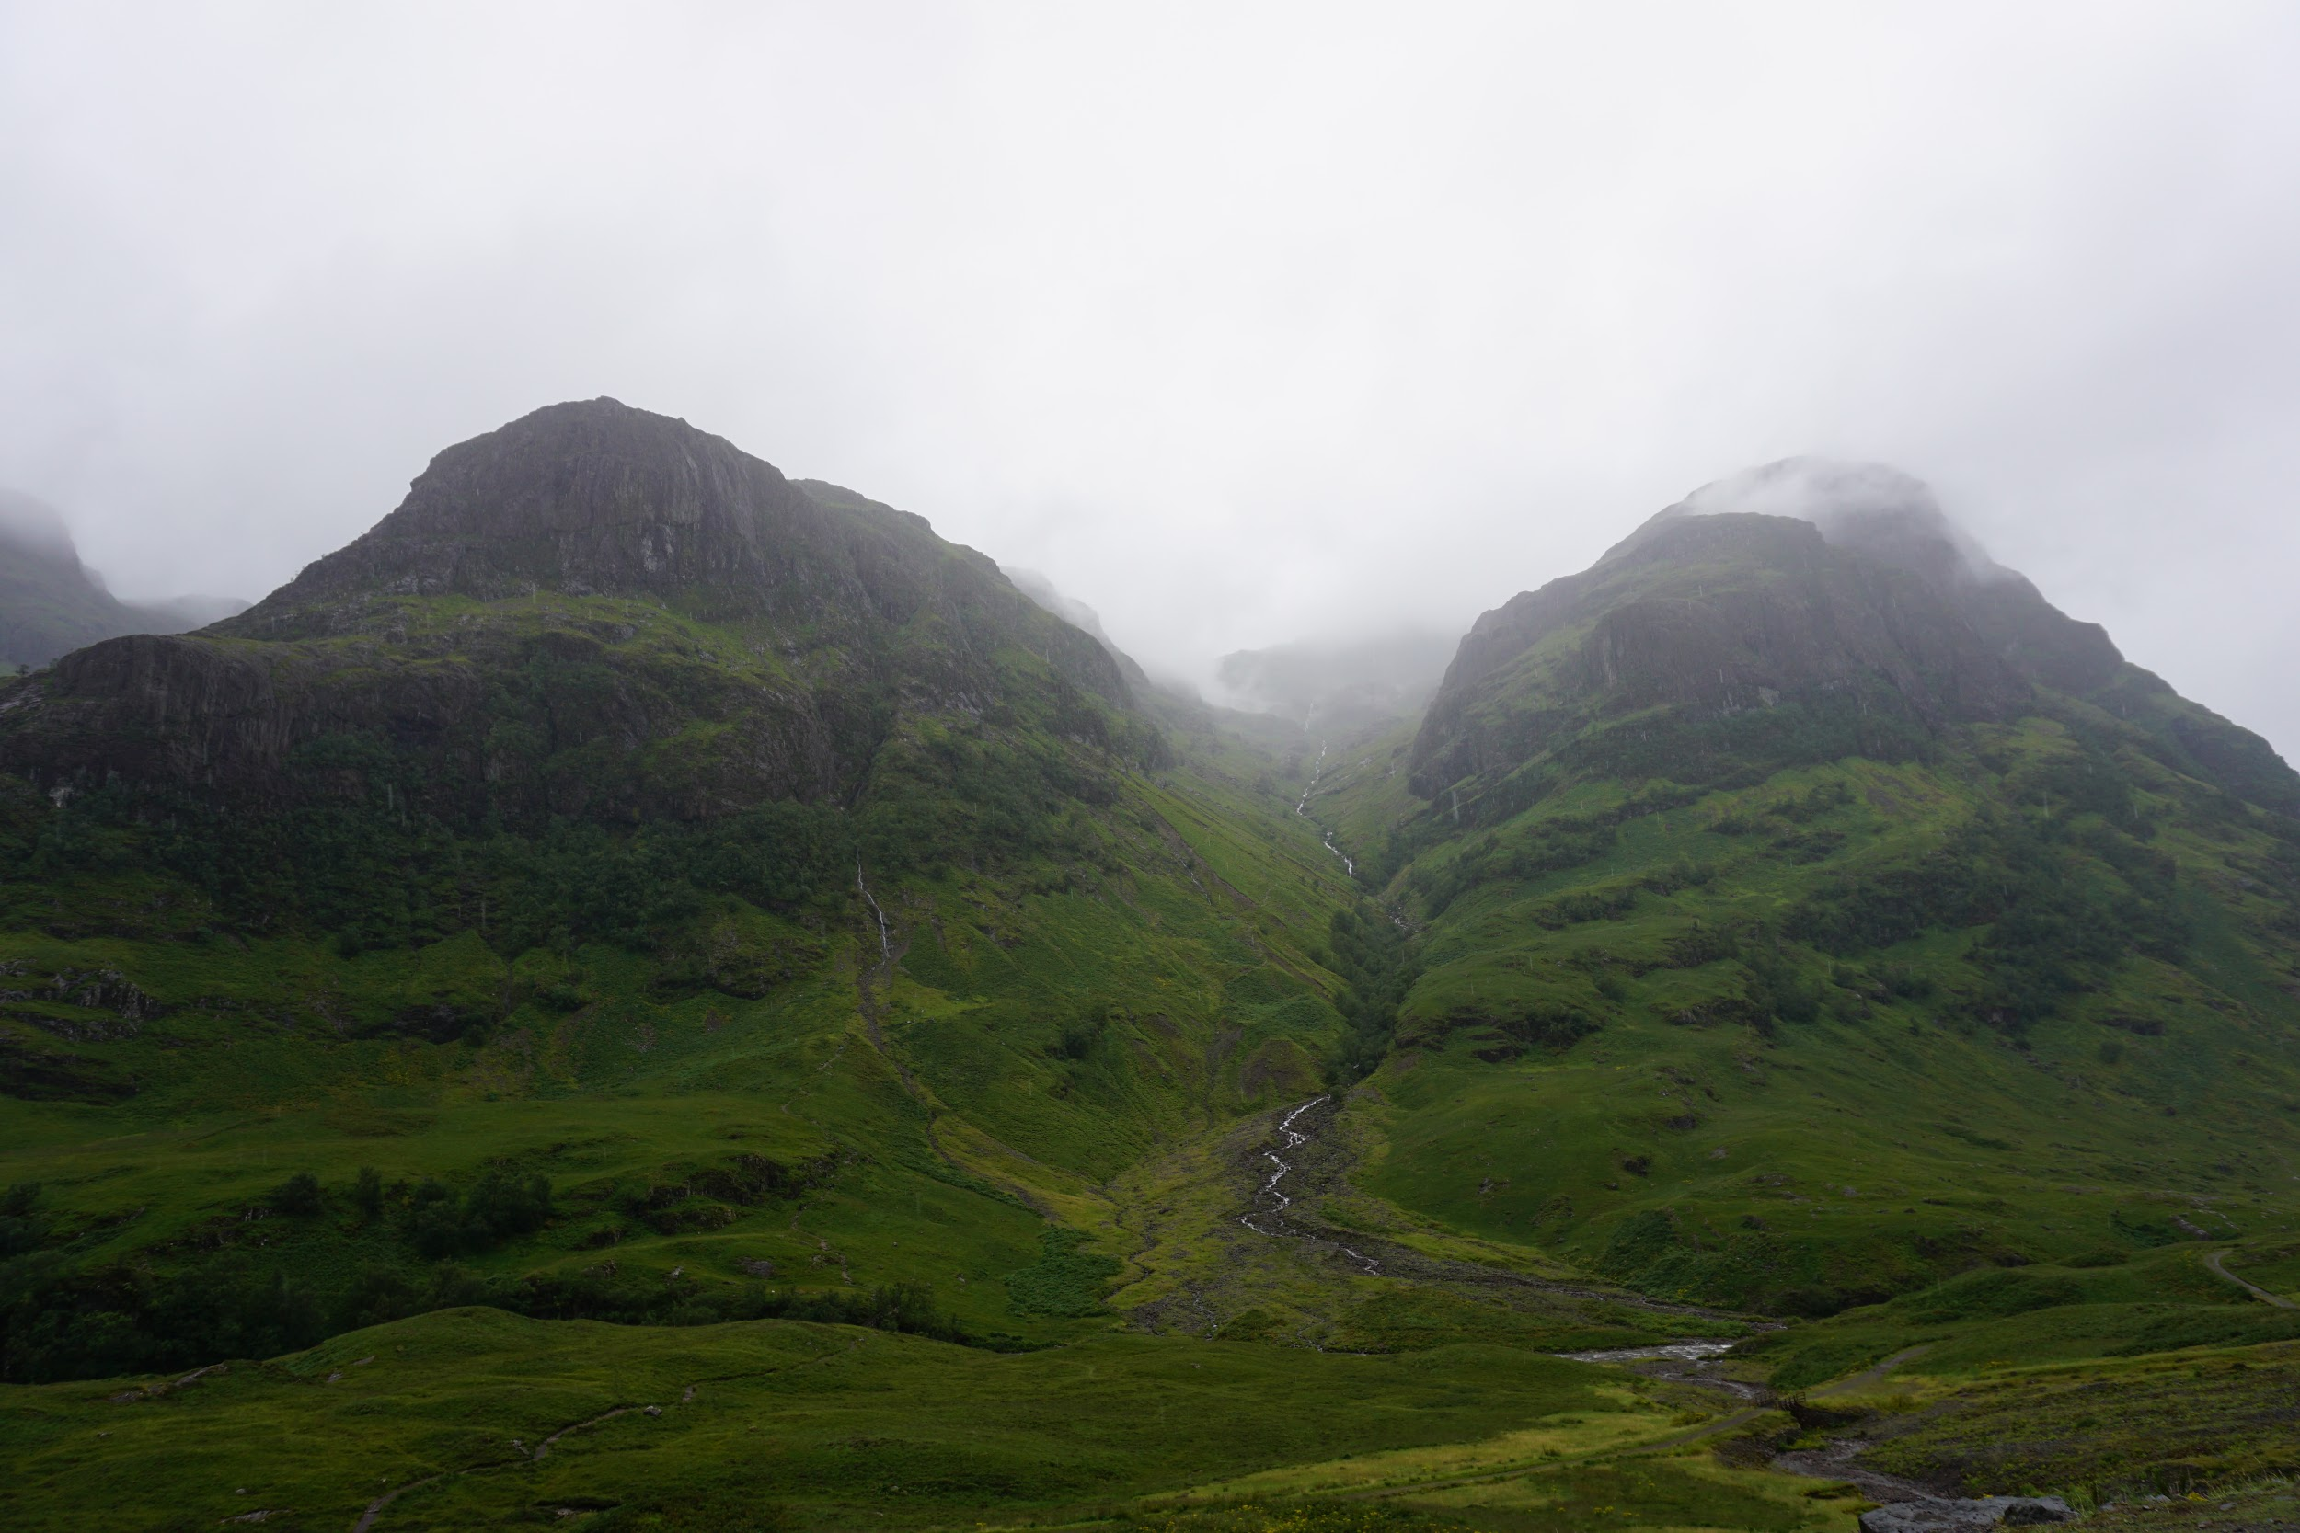
Notes:
Two of three sisters, Glen Coe

Slide 7
Lectures at SUISS
MODERNISM:
Imagist poetry
The Wasteland, T.S. Eliot
Katherine Mansfield short stories
Good Morning, Midnight, Jean Rhys
SCOTTISH LITERATURE:
Sunset Song, Lewis Grassic Gibbon
Black Watch, Gregory Burke
Janice Galloway short stories
A.L. Kennedy short stories
TEACHING EFFECTS:
AP Literature: Symbolism using Janice Galloway’s “Jellyfish”
AP Language: Arguments by T.S. Eliot & visual rhetoric in Black Watch
English 9H: Selections from Sunset Song for making a complex character in their own short stories

Slide 8
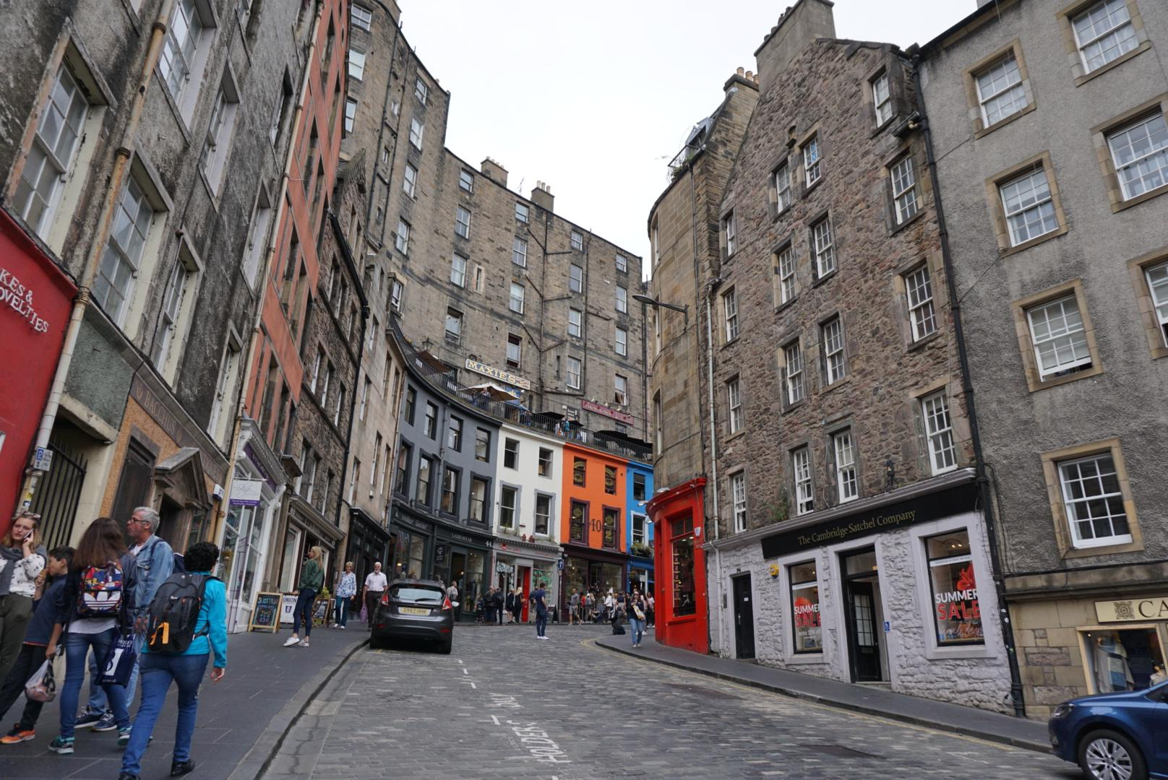

Slide 9
Writing Workshops at SUISS
6 PARTICIPANTS & 1 MENTOR, 4-5 DAYS A WEEK
Produced 4 pieces for workshop
Produced 4 pieces for 1-1 mentor
Discussed fiction, poetry
Discovered writing exercises
TEACHING:
AP Literature: Lesson on characterization using “What We Talk about When We Talk about Love”
Writing exercises used in English 9H & Creative Writing Club
Development of syllabus for Creative Writing
PERSONAL:
Developing characters and stories
Editing one short story from 1-1
Entered “Pitch Wars”

Slide 10
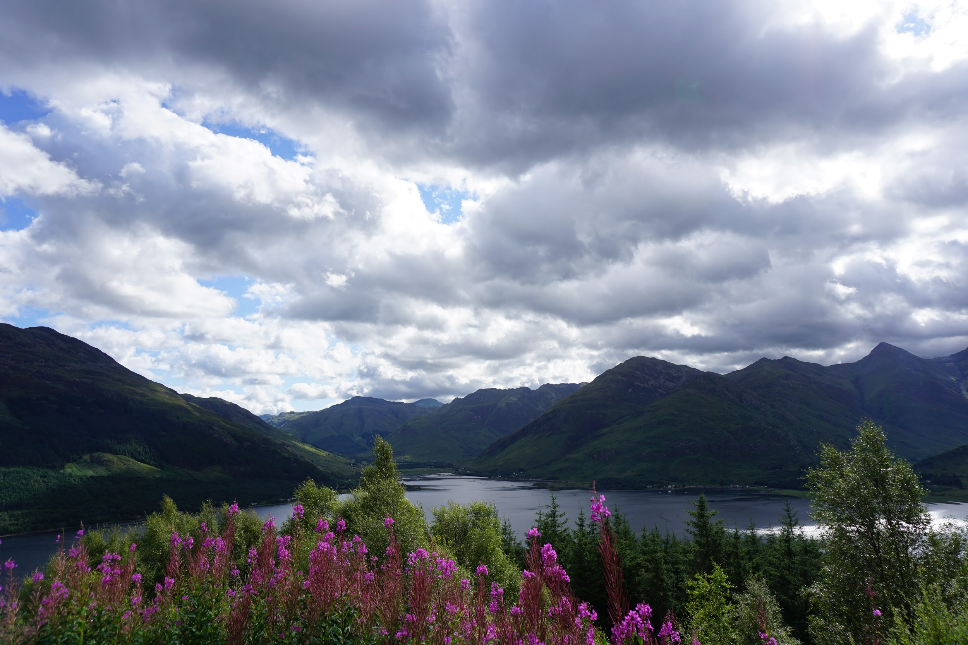
Notes:
Five Sisters Of Kintail

Slide 11
Writing Masterclasses at SUISS
TWO-HOUR INTENSIVES:
Zoe Strachan (Scottish novelist), Colin Herd (English poet), Rachel McCrum (Irish poet), Damon Herd (Scottish comic artist), & Russell Jones (Scottish speculative writer)
TEACHING:
(Planned) Creative Writing: Comic book development
English 9H: Using art to generate story ideas
Creative Writing Club: Description exercises
Notes:
Zoe - description, Colin - process and making mistakes, Rachel McCrum- translation, Damon - comic & stories, Russ Jones - what if?

Slide 12
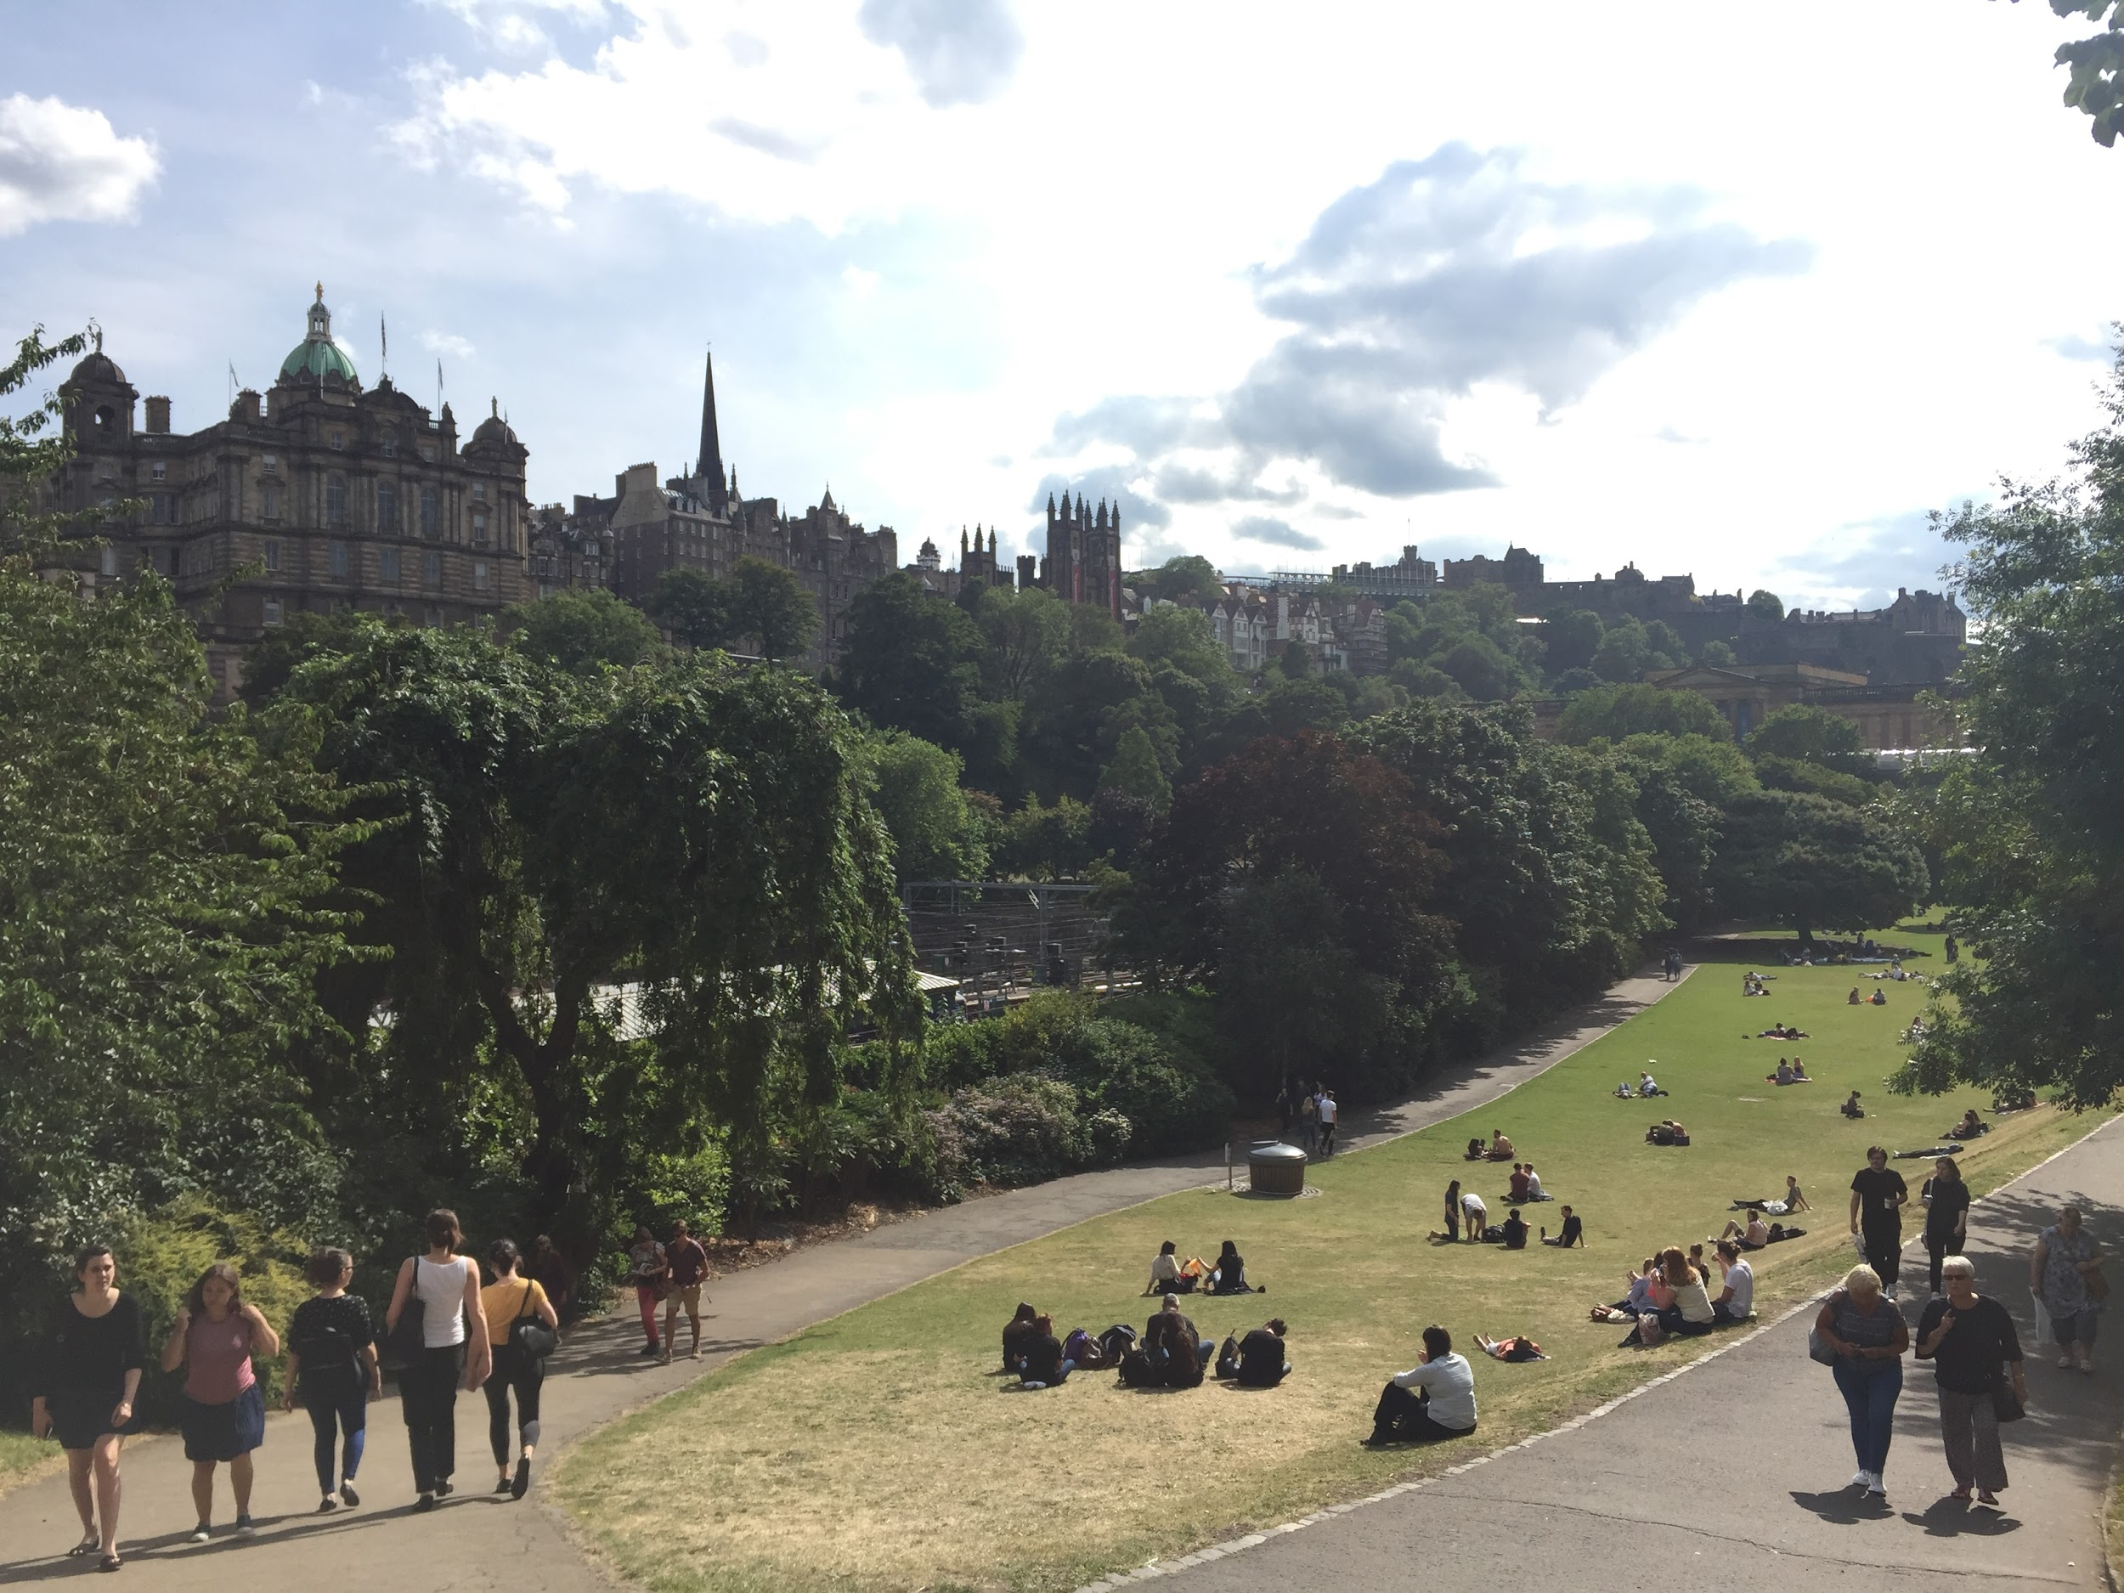

Slide 13
Writing Exercise:
Describe an old man looking at a barn. The old man’s son has just died in a war. You cannot mention the son, death, or war.

Slide 14
The paint slowing slinking down the side
Red like the blood of the fallen
Not fresh
But dried and stale like a cracker
A cracker smashed by the hand of the world

Slide 15
Despite the exterior looking fairly intact, the barn fell out of use long ago. He was reminded of those humid summer days, heavy with the stench of manure, when those hearty horses were still shuffling about in their stables. One by one they went until that barn was as empty as it was the day he first stepped foot in it. The building had lost all purpose, yet here he was once again, trying to recapture something he could not bring himself to name.

Slide 16
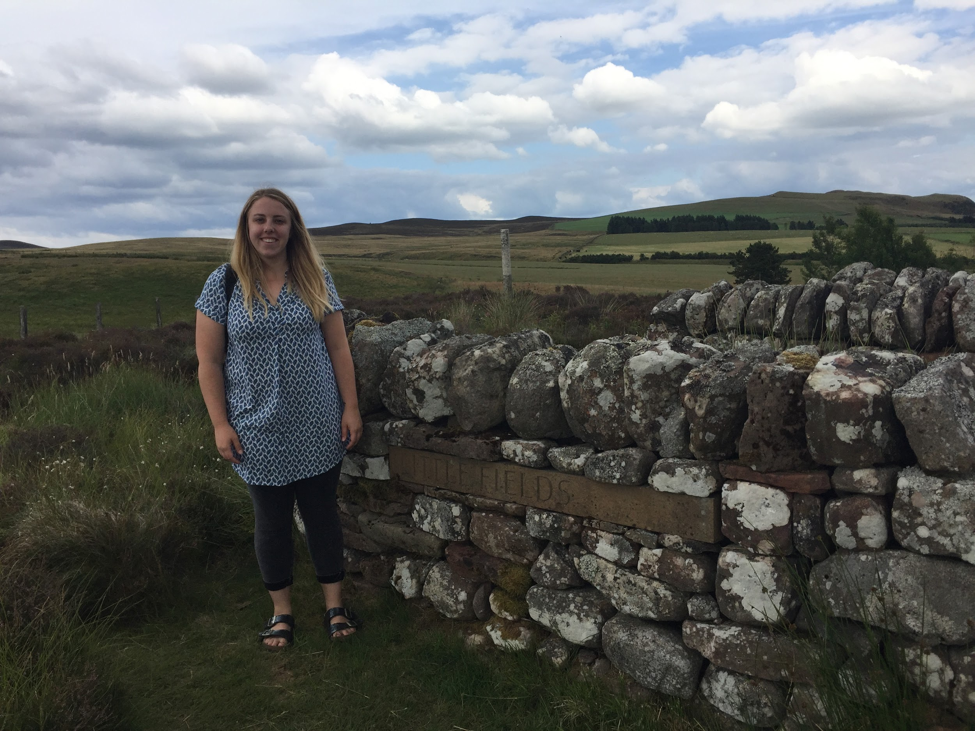
Notes:
Ian Hamilton Finlay - avant gardener

Slide 17
Author & Poet Readings at SUISS
READINGS BY OTHERS:
Novelist James Robertson
Author Janice Galloway
Poets JL Williams & Colin McGuire
Poet Patrick Errington
PARTICIPANT READINGS:
Open Mics
CinePoem Challenge
Ceilidh
TEACHING:
(Planned) Creative Writing: CinePoem Challenge
AP Literature: Janice Galloway
(Planned) Creative Writing: Poem in the style of P. Errington

Slide 18


Slide 19

Notes:
Ceilidh

Slide 20
Cultural Excursions at SUISS
WITH SUISS:
Scottish Poetry Library
University of Edinburgh library
Arthurs’ Seat
Ian Hamilton Finlay’s “Little Sparta”
City Art Centre
Fruit Market Art Museum
Scottish Parliament
INDEPENDENTLY (ABRIDGED):
Scottish Writers Museum
Pentland Hills
Holyrood Palace
Harry Potter walking tour
Isle of Skye
St Andrews
Paris & Normandy

Slide 21
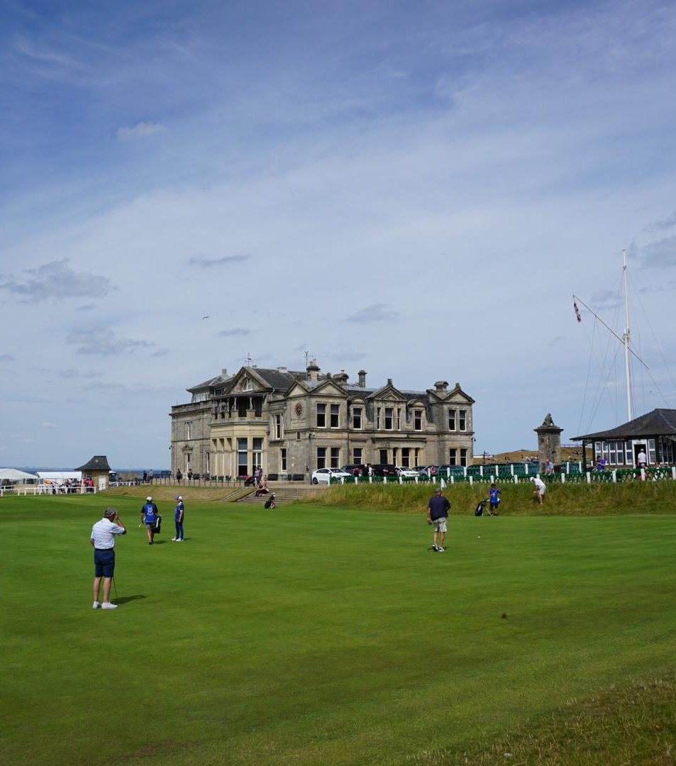
Thank you,
ESU Indianapolis
I learned a tremendous amount, had unforgettable adventures, and experienced the most impactful summer of my life. It would not have been possible without you. Thank you!

